Slide 1
Appointment Application
Belinda Whitman
CS 470

Slide 2
Background
The client is a local outpatient therapy clinic specializing in upper extremity rehabilitation.
There are 7 occupational therapists and one physical therapist.
The clinic works with various physicians around town who refer patients.
Currently receptionist receives all new appointments.

Slide 3
Goals
  To automate the appointment system for a local outpatient therapy clinic.
  To give the clinic the ability to track patients on a small scale.
Purpose
  To manage schedules for therapists
  To allow quick access to patient, employee, or referring doctor information.
  To create a graphical interface to an appointment database that is easy to use without the knowledge of SQL.

Slide 4
Why Create a GUI?
Client has limited knowledge of Microsoft Access.
Appointment Table difficult to read without the use of SQL.
Most users love to click!

Slide 5
Methodology
Prototyping method
  Interview process
  Several Mock ups created
  Process is still ongoing
Visual Basic 6.0 and Microsoft Access 97

Slide 6
Data Files
Relational Database containing five tables
  Doctor
  Patient
  Therapist
  Appointment
  Login

Slide 7
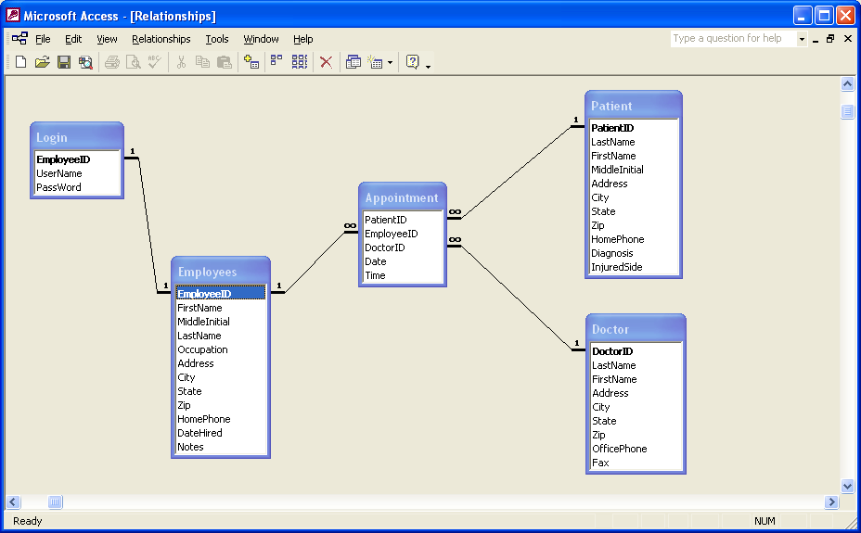
Data Model

Slide 8
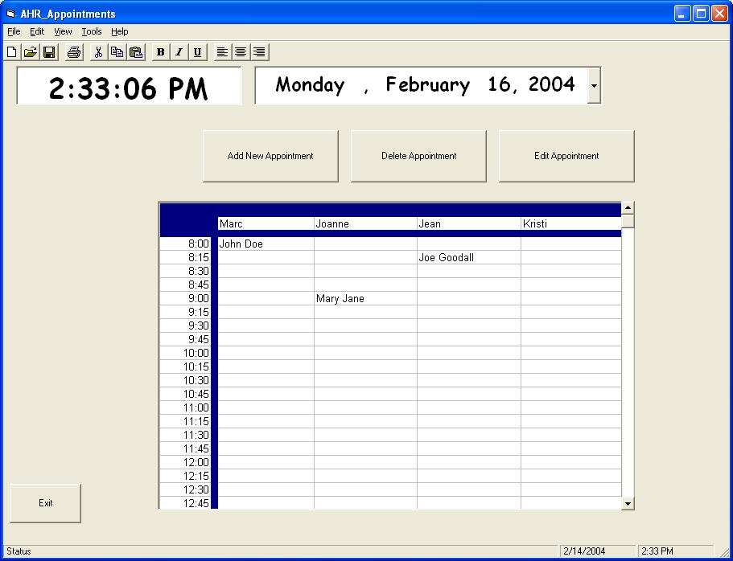
Preliminary Mock Up

Slide 9
Application Design
ActiveX Data Objects made the process of searching, adding and updating tables easier.
Main window allows the user to double click an appointment “cell” to enter a new appointment.
Double click a “cell” with an appointment, an edit window will open and allow the user to edit or delete the appointment.

Slide 10
Application Design
Calendar control.
Clock with current time.
Currently each cell is only able to show one appointment. This will change (probably not before demo day).
The user has the option to edit (which includes delete), add, and search each table from the specified menu.

Slide 11
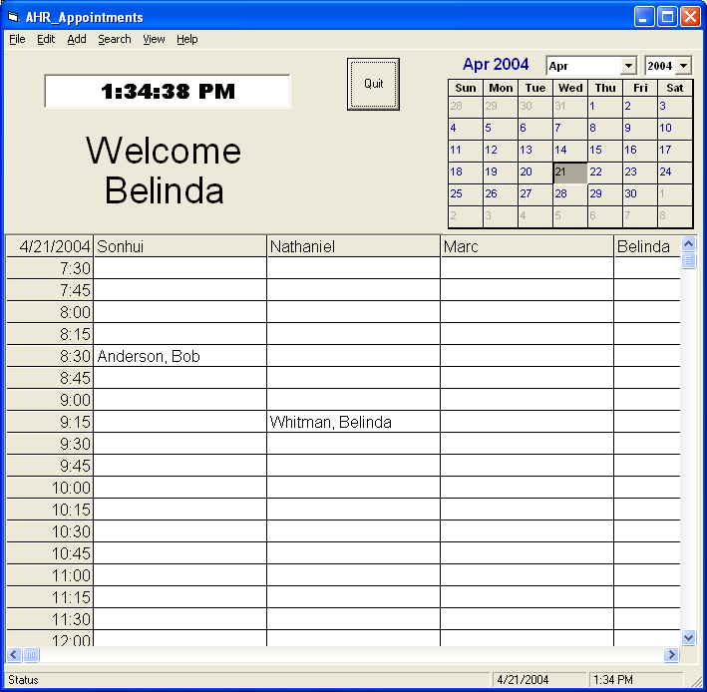
Final Main Screen

Slide 12
System Specification
Microsoft Access 97 or higher
Visual Basic 6.0
Windows 95, 98, 2000 or XP
Pentium
32 MB RAM
20 MB Hard Drive Space

Slide 13
Conclusion
Creation of an appointment application that will be used by a local outpatient clinic.
I have gained extensive knowledge of prototyping, working with a client, and my own patients.
The potential growth for this project is possible beyond this class, but remains to be seen.

Slide 14
Lessons Learned
Clients can be easy and difficult to work with.
Do not underestimate the project. Even what appears to be a simple project can turn evil
Most important lesson of all... Do not take 470 and 401 together in the same semester. Especially during a semester you choose to take 18 credit hours!

Slide 15
Thank you!
Questions? (I’m sure there will be!)

